Slide 1
Introduction to Pytorch
Parker Gage

Slide 2
Background
Lua Torch
Open source machine learning library
One of the largest machine learning libraries
Primarily used for research
Able to utilize GPU’s for simultaneous calculations
Nvidia’s CUDA

Slide 3
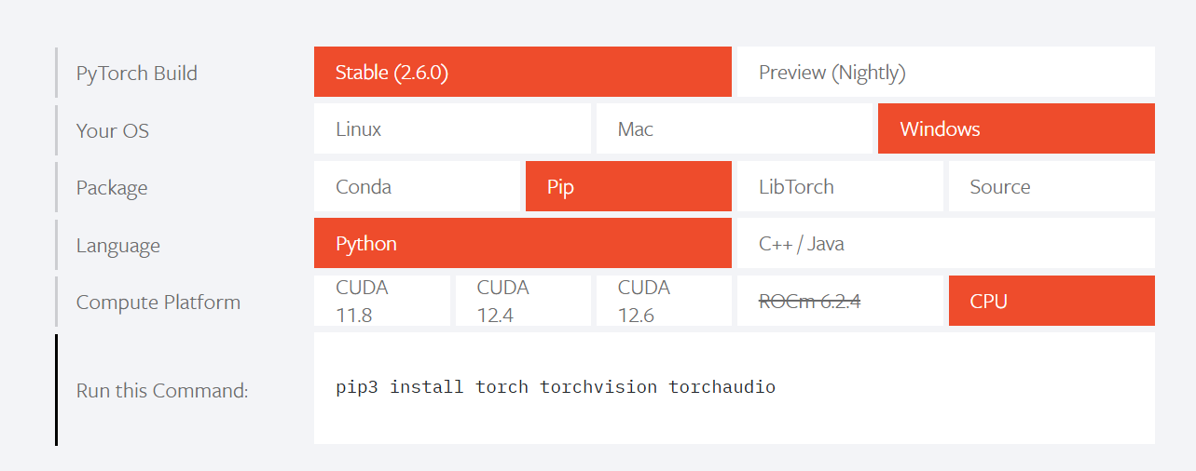
How to Install
Notes:
Link: PyTorch

Slide 4
Machine Learning Framework
Gather the data
Data preparation
Model selection and/or model training
Model evaluation

Slide 5
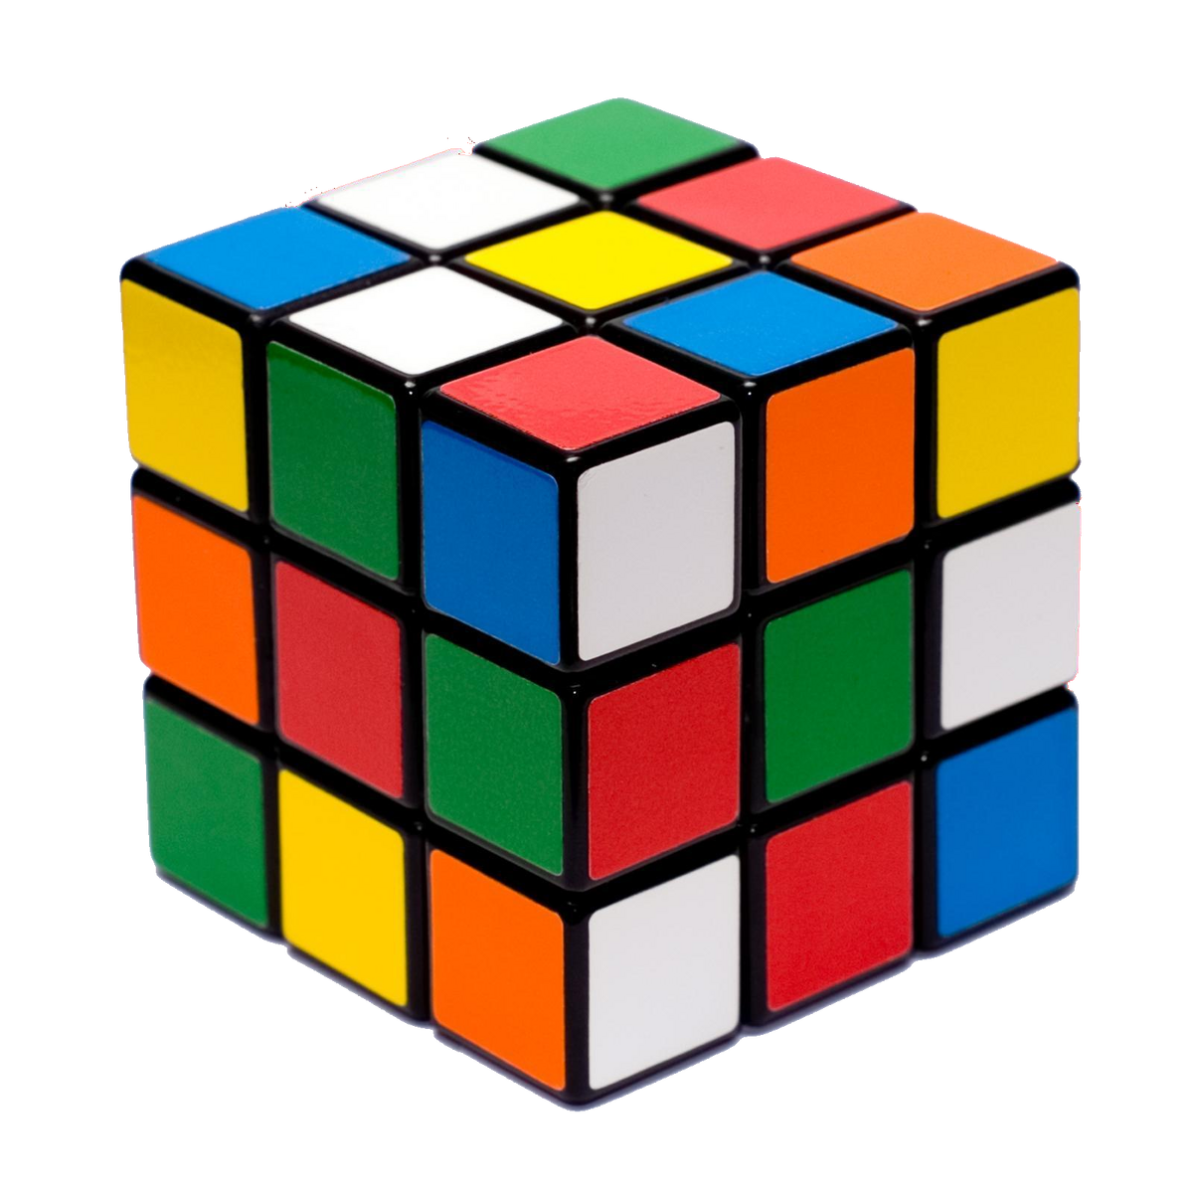
Core Concepts
Tensor
Tensor is an N-dimensional array
Scalar
Vector
Matrix
Notes:
Tensor’s are similar

Slide 6
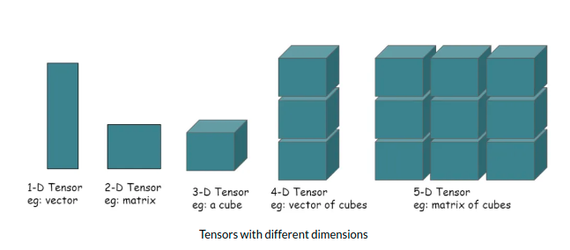
Tensor Examples
3d Tensor:
RGB Picture
Height, Width and Color
4d Tensor:
RGB Video
Height, Width, Color and Time

Slide 7
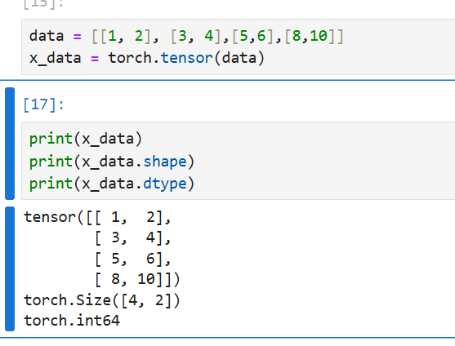
Tensor Code Example
torch.tensor – creates a tensor
variable.shape
variable.dtype
torch.ones

Slide 8
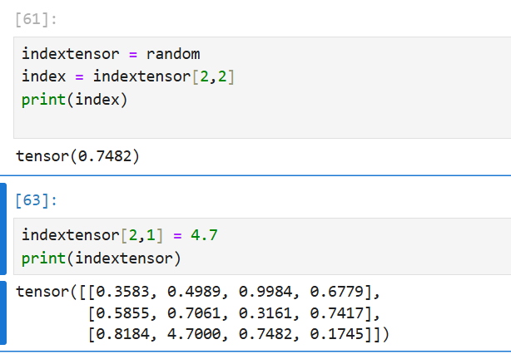
Tensor’s Continued
Can look at scalars
Replace numbers
Do arithmetic +,-,*,/

Slide 9
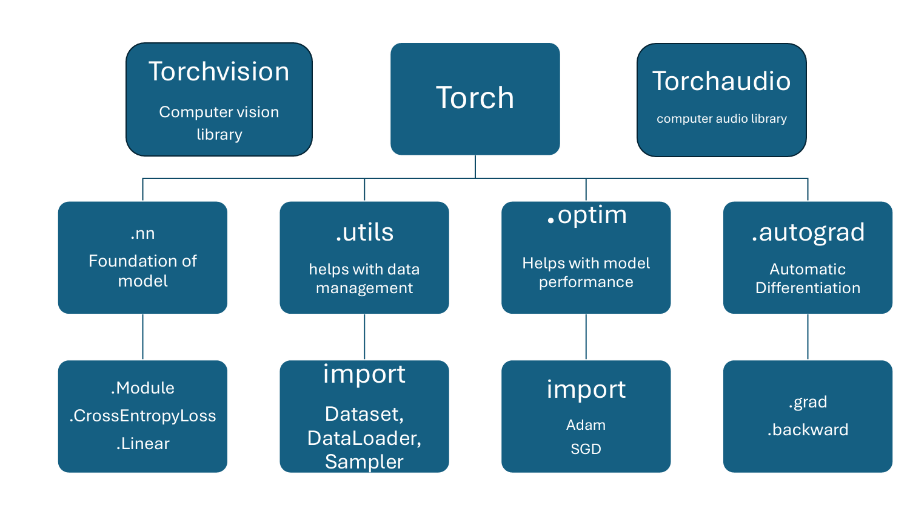
Pytorch Modules
Torch
Torchvision
Torchaudio
Notes:
Pytorch consists of three main modules: Torch, Torchvision and Torchaudio. Torchvision and Torchaudio are specific libraries for computer vision and computer audio recognition. Torch is the primary library that allows data scientist to build their own models. It consists of many modules such as .utils, or .nn. You use these to assist in training or building a model.
Additional information on each module:
Torchvision: Transforming and augmenting images — Torchvision 0.21 documentation
Torch: torch — PyTorch 2.6 documentation
Torchaudio: Torchaudio Documentation — Torchaudio 2.6.0 documentation

Slide 10
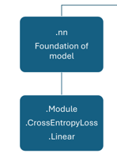
Torch.nn
Torch.nn.Linear
Used to create a linear layer in your model
Torch.nn.Module
Is the foundation of the custom model that you create.
Torch.nn.crossentropyloss
Loss function, difference between model prediction and result

Slide 11
Torch.utils
Torch.utils.data import Dataset
Helps you import your data into a tensor.
Torch.utils.data import DataLoader
Lets you change settings like batch size or is the data going to be randomized

Slide 12

Torch.optim
Helps you optimize your model
Changing of weights and help you refine your model.
Popular premade optimizers include Adam and SGD

Slide 13
Torch.autograd
Forward Propagation – looks at the inputs and runs them through its neural networks to arrive at the output.
Backward Propagation – starts at the output and works its way backwards using partial derivatives.
Notes:
A Gentle Introduction to torch.autograd — PyTorch Tutorials 2.6.0+cu124 documentation

Slide 14
Bibliography
https://ai.meta.com/tools/pytorch/
https://static.wikia.nocookie.net/speedsolving/images/a/a1/Rubik%27s_Cube_transparency.png/revision/latest/scale-to-width-down/1200?cb=20141018181906
https://media.licdn.com/dms/image/v2/D4D12AQGBWEH55J0srw/article-cover_image-shrink_600_2000/article-cover_image-shrink_600_2000/0/1686308835063?e=2147483647&v=beta&t=unycJxyxEuLjKUY9yoB2P6WgKP8j5-QITqkV9jYln-Y
Autograd mechanics — PyTorch 2.6 documentation
A Gentle Introduction to torch.autograd — PyTorch Tutorials 2.6.0+cu124 documentation
Torchvision: Transforming and augmenting images — Torchvision 0.21 documentation
Torch: torch — PyTorch 2.6 documentation
Torchaudio: Torchaudio Documentation — Torchaudio 2.6.0 documentation

